Slide 1
Disaster recovery with IBM cloud virtual server

Slide 2
Innovative approaches to disaster recovery with IBM Cloud virtual servers involve leveraging cutting-edge technologies and methodologies to enhance resilience, reduce recovery times, and optimize resource utilization. Here are some innovative aspects you can consider:
Serverless Architectures:
Explore serverless computing models to reduce infrastructure management overhead.
Utilize IBM Cloud Functions for event-driven, scalable compute without the need to provision or manage servers.

Slide 3
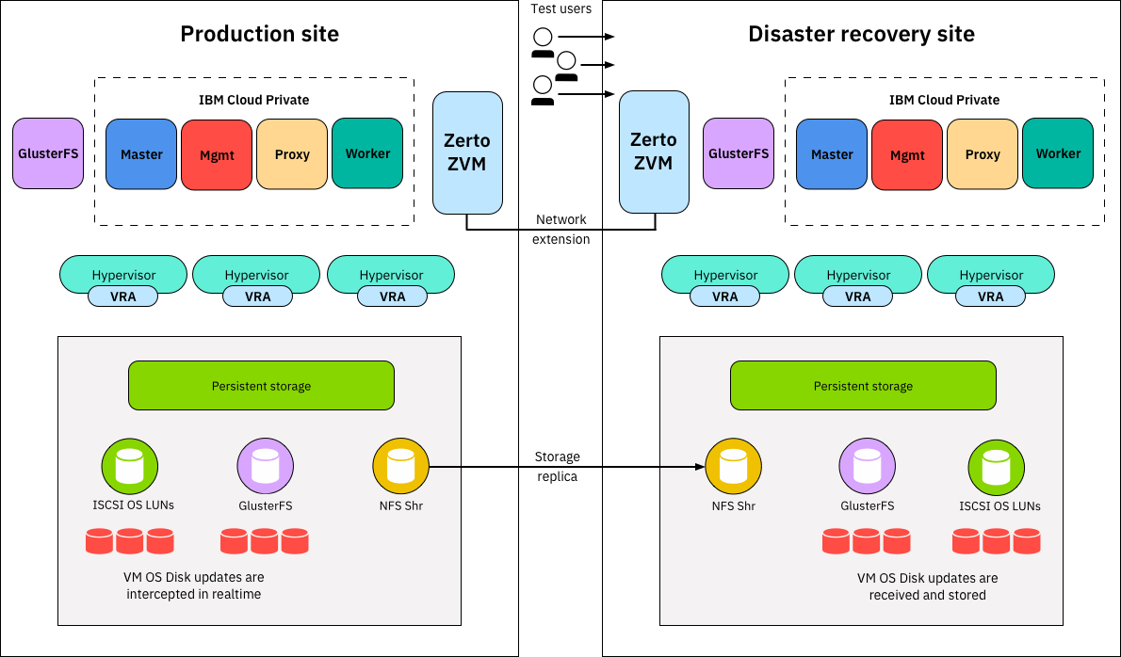
2. Microservices and Containers:
Adopt a microservices architecture with containerization using tools like Kubernetes on IBM Cloud Kubernetes Service.
Container orchestration enables rapid deployment, scaling, and simplified management of applications.
3. AI-Driven Automation:
Integrate artificial intelligence (AI) for intelligent automation in disaster recovery processes.
Use AI for predictive analysis, anomaly detection, and automated decision-making during recovery.

Slide 4
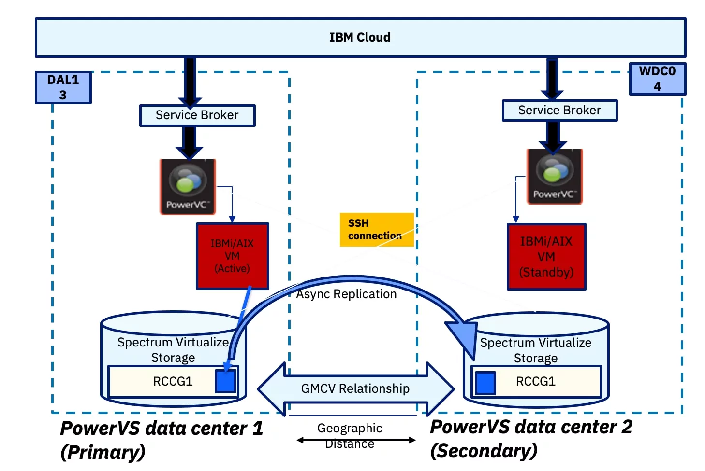
4. Blockchain for Data Integrity:
Implement blockchain technology for ensuring the integrity and immutability of critical data during the recovery process.
Blockchain can enhance data trustworthiness and security.
5. Multi-Cloud and Hybrid Deployments:
Build disaster recovery solutions that span multiple cloud providers for increased redundancy.
Utilize IBM Cloud Satellite for consistent hybrid cloud operations across on-premises, edge, and multi-cloud environments.

Slide 5
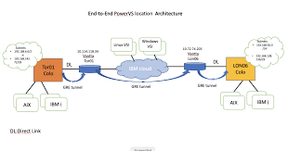
6. Edge Computing for Resilience:
Extend disaster recovery capabilities to the edge with edge computing solutions.
Leverage IBM Edge Application Manager to manage and deploy workloads across edge devices.
7. Quantum Computing for Optimization:
Investigate the potential of quantum computing for optimizing disaster recovery algorithms.
Quantum computing may offer solutions for complex optimization problems related to resource allocation and recovery strategies.

Slide 6
8. Immutable Infrastructure:
Implement the concept of immutable infrastructure, where server instances are never modified but replaced.
This ensures consistency and reduces the risk of configuration drift.
9. Zero Trust Security Model:
Adopt a zero-trust security model to enhance security during disaster recovery.
Implement multi-factor authentication, continuous monitoring, and least privilege access controls.
10. Continuous Integration/Continuous Deployment (CI/CD):
Implement CI/CD pipelines for automated testing and deployment of applications and configurations.
This ensures that updates are consistently applied and validated.

Slide 7
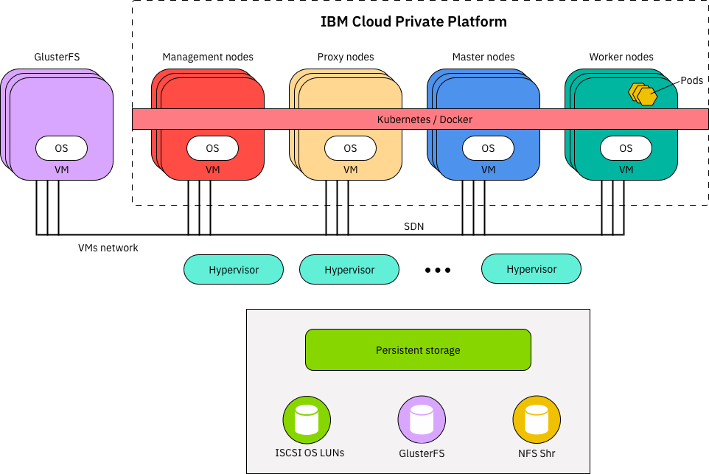
11. Self-Healing Systems:
Leverage self-healing systems that automatically detect and recover from failures.
Use IBM Cloud services and tools that support automatic scaling and healing.
12. Augmented Reality (AR) for Incident Response:
Explore AR technologies for enhancing incident response and decision-making during a disaster.
AR can provide real-time information and guidance to recovery teams.
13. Digital Twin Technology:
Implement digital twin technology for creating virtual replicas of your infrastructure.
Digital twins can be used for testing and simulating disaster recovery scenarios.

Slide 8
Thank You

